Slide 1
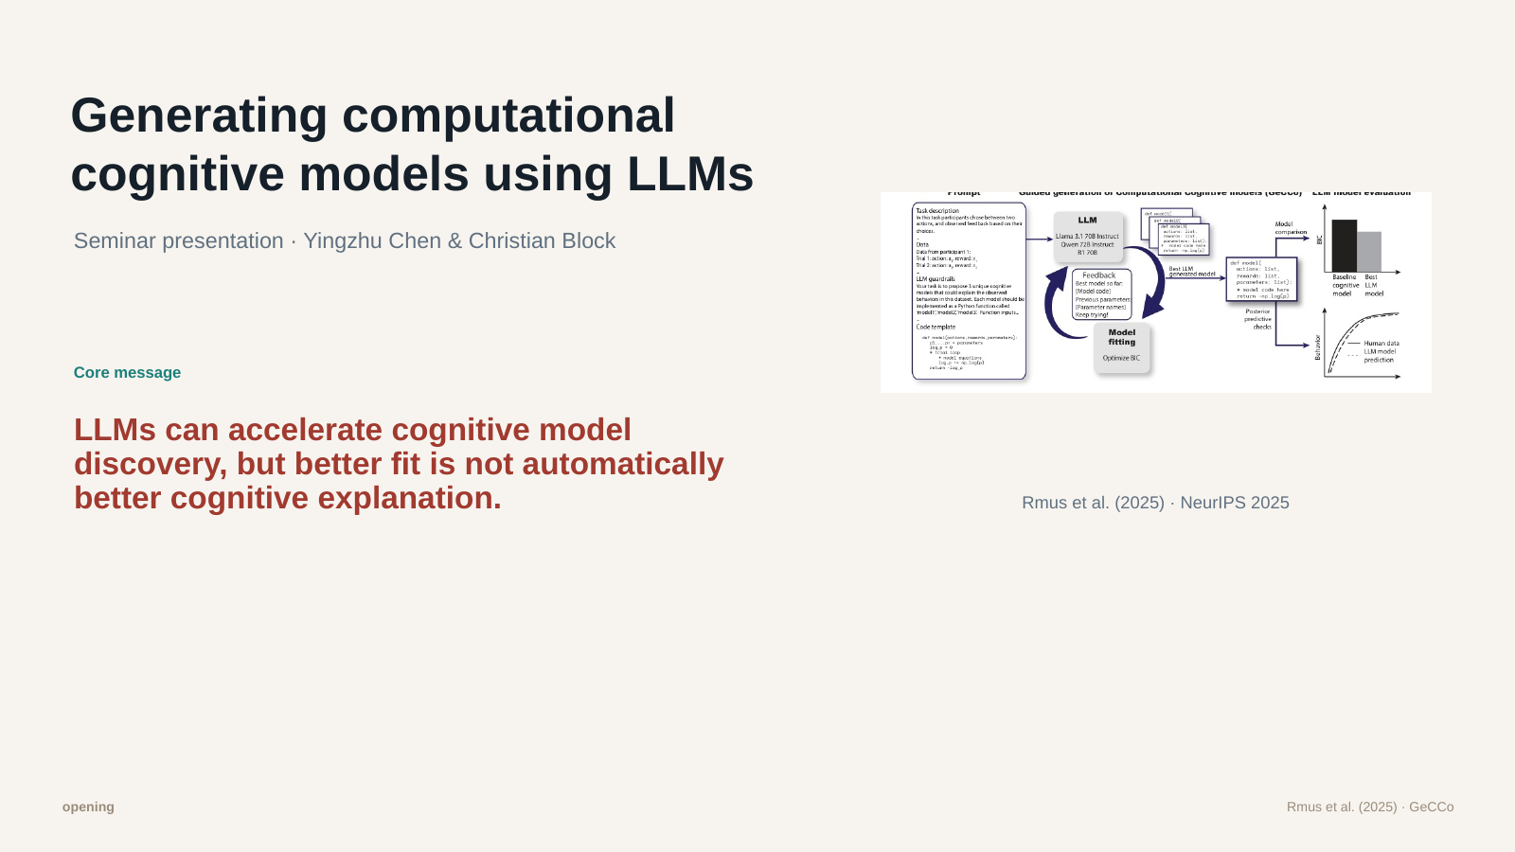
Slide 1: Opening
Speaker 1 · bilingual oral script / 双语口语讲稿
ENGLISH
中文
Hi everyone. Today we are going to present the paper Generating Computational Cognitive Models using Large Language Models by Rmus and colleagues.
The main idea is simple: can we use LLMs not only to write text, but also to write cognitive models? Can an LLM look at a task and human behavior data, and then propose a model that explains how people make choices?
Our main message is: LLMs can make cognitive model discovery much faster, but a better model fit does not automatically mean a better explanation of human thinking.
So we will explain both sides: why GeCCo is useful, and why human judgment is still needed.
大家好。今天我们要介绍的是 Rmus 等人的论文：Generating Computational Cognitive Models using Large Language Models。
这篇文章的核心想法其实很简单：LLM 能不能不只是写文字，也用来写认知模型？也就是说，LLM 能不能看懂一个任务和一些人类行为数据，然后提出一个模型，解释人是怎么做选择的？
我们今天的主线是：LLM 可以让认知模型发现变得更快，但模型拟合更好，并不自动等于它就是更好的心理解释。
所以接下来我们会讲两面：GeCCo 为什么有用，以及为什么最后仍然需要人的判断。
Corresponds to final PPT slide 1

Slide 2
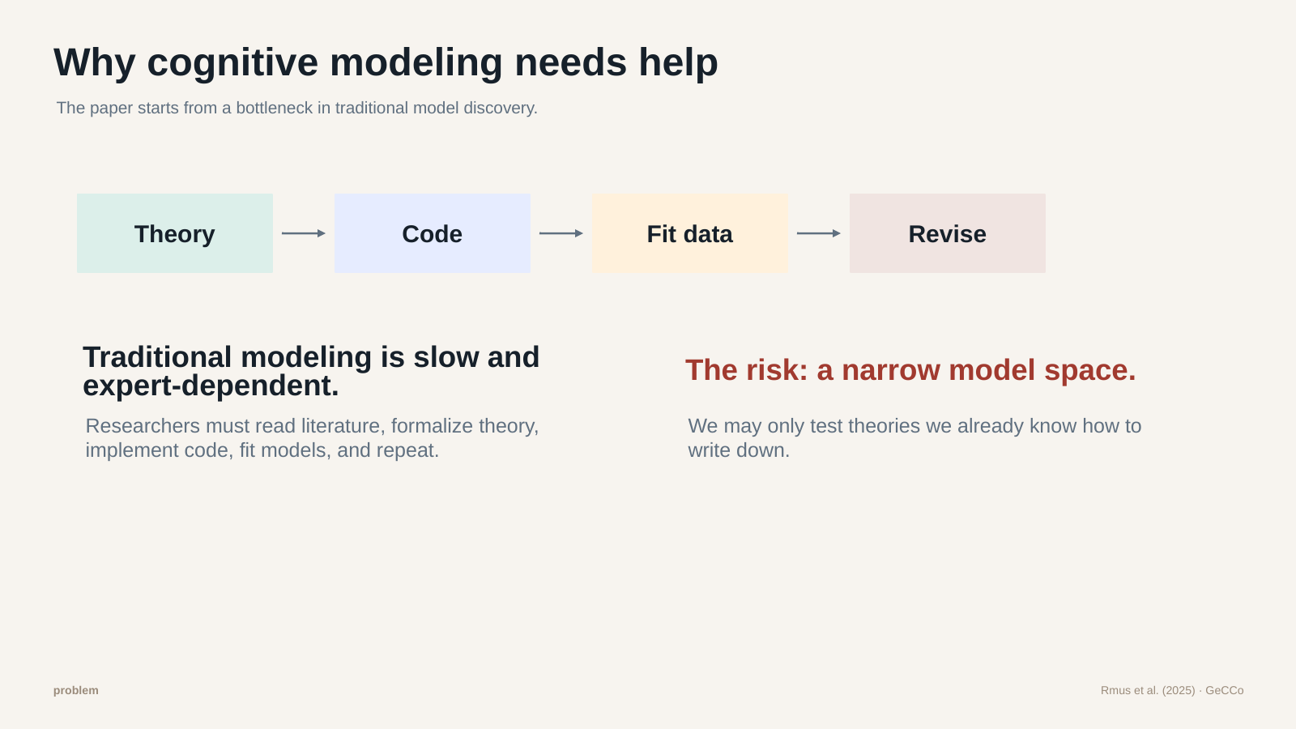
Slide 2: Why cognitive modeling needs help
Speaker 1 · bilingual oral script / 双语口语讲稿
ENGLISH
中文
Before explaining GeCCo, we first need the problem.
In cognitive science, researchers often explain behavior with models. For example, if people learn from rewards, we want to write down how they update choices.
Traditionally, humans do this: read literature, form a theory, write equations or code, fit the model, check the result, and revise it.
This is powerful, but slow. It needs theory knowledge, programming skills, and time.
There is also bias: researchers may mostly test models they already know. So the question is: can LLMs help us explore a wider model space?
在讲 GeCCo 之前，我们先看问题在哪里。
在认知科学里，研究者经常用模型来解释人的行为。比如，如果人会从奖励中学习，我们就想把“他们怎么更新选择”明确写出来。
传统做法基本都靠人：读文献，提出理论，写公式或代码，拟合数据，看结果，再修改模型。
这种方法很强，但很慢。它需要理论知识、编程能力，也需要很多时间。
另外还有一个偏差：研究者可能更容易测试自己熟悉的模型。所以这篇文章的问题就是：LLM 能不能帮我们探索更大的模型空间？
Corresponds to final PPT slide 2

Slide 3
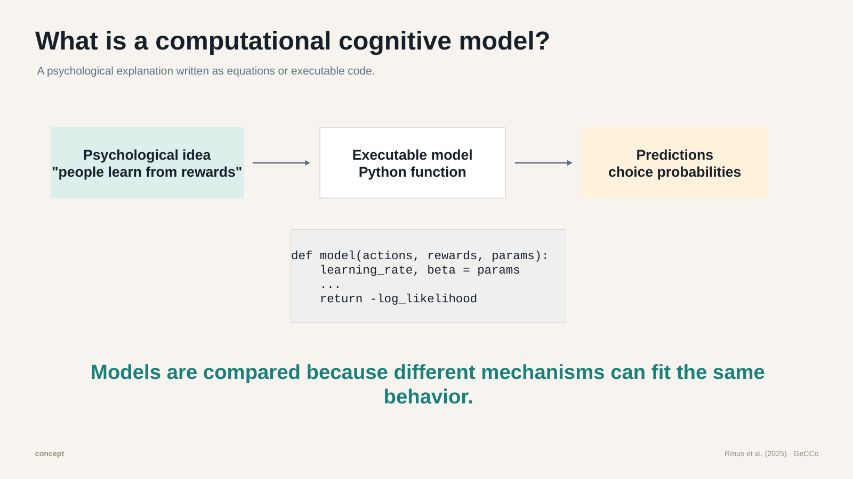
Slide 3: What is a computational cognitive model?
Speaker 2 · bilingual oral script / 双语口语讲稿
ENGLISH
中文
Let us clarify one term: computational cognitive model.
A computational cognitive model is a psychological explanation written in a formal way. It can be equations, or executable code.
For example, a simple idea is: people learn from rewards. If an action gives a reward, they become more likely to choose it again.
A model turns this idea into code. The code takes actions, rewards, and parameters, then outputs choice probabilities or a negative log-likelihood.
This matters because different ideas can explain the same behavior. Model comparison asks which explanation predicts the data better while staying simple.
这里先解释一个重要概念：计算认知模型。
计算认知模型就是把一个心理学解释，用形式化方式写出来。它可以是公式，也可以是能运行的代码。
比如一个很简单的想法是：人会从奖励中学习。如果某个行为带来奖励，人下次就更可能再选它。
模型会把这个想法写成代码。代码输入行为、奖励和参数，然后输出每个选择的概率，或者整个行为序列的负对数似然。
这很重要，因为不同理论有时都能解释同一组行为。模型比较就是问：哪个解释预测数据更好，同时又更简单？
Corresponds to final PPT slide 3

Slide 4
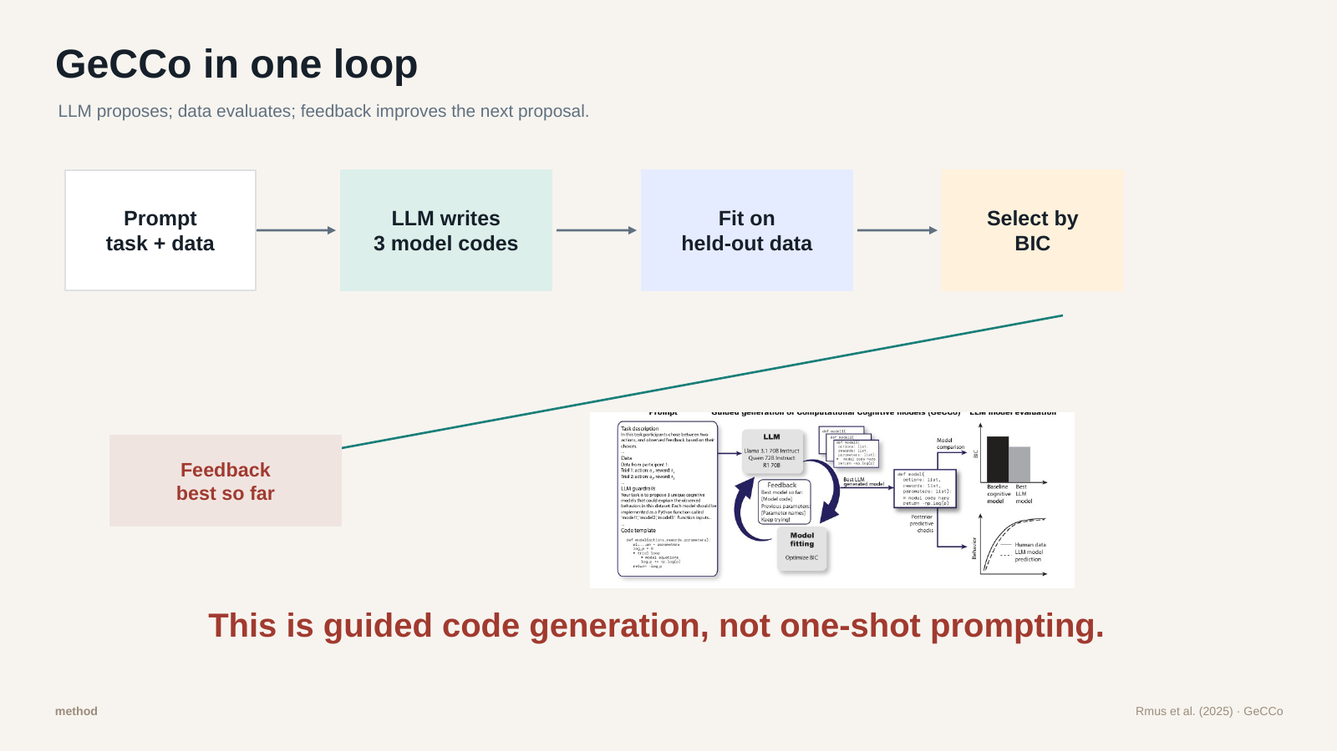
Slide 4: GeCCo in one loop
Speaker 2 · bilingual oral script / 双语口语讲稿
ENGLISH
中文
This slide shows the core loop of GeCCo.
First, the LLM gets a prompt. The prompt includes the task, some behavior data, and instructions about what kind of Python function to write.
Then the LLM writes three possible cognitive models as code.
GeCCo does not simply trust the LLM. The models are fitted on held-out human data, and the best one is selected using BIC.
Then the best model so far is sent back as feedback. So the LLM tries again in the next round.
In short: generate, test, give feedback, and generate again. The LLM proposes, but the data evaluates.
这页展示的是 GeCCo 最核心的循环。
第一步，LLM 会收到一个 prompt。这个 prompt 里有任务说明、一部分行为数据，以及它应该写什么样的 Python 函数。
然后，LLM 会写出三个可能的认知模型，也就是三段代码。
但 GeCCo 不是直接相信 LLM。它会把这些模型放到留出的人工行为数据上拟合，然后用 BIC 选出目前最好的模型。
接着，这个“目前最好模型”会作为反馈，再给回 LLM，让它下一轮继续改进。
简单说就是：生成模型，测试模型，给反馈，再生成。LLM 负责提出模型，但由数据来评价模型。
Corresponds to final PPT slide 4

Slide 5
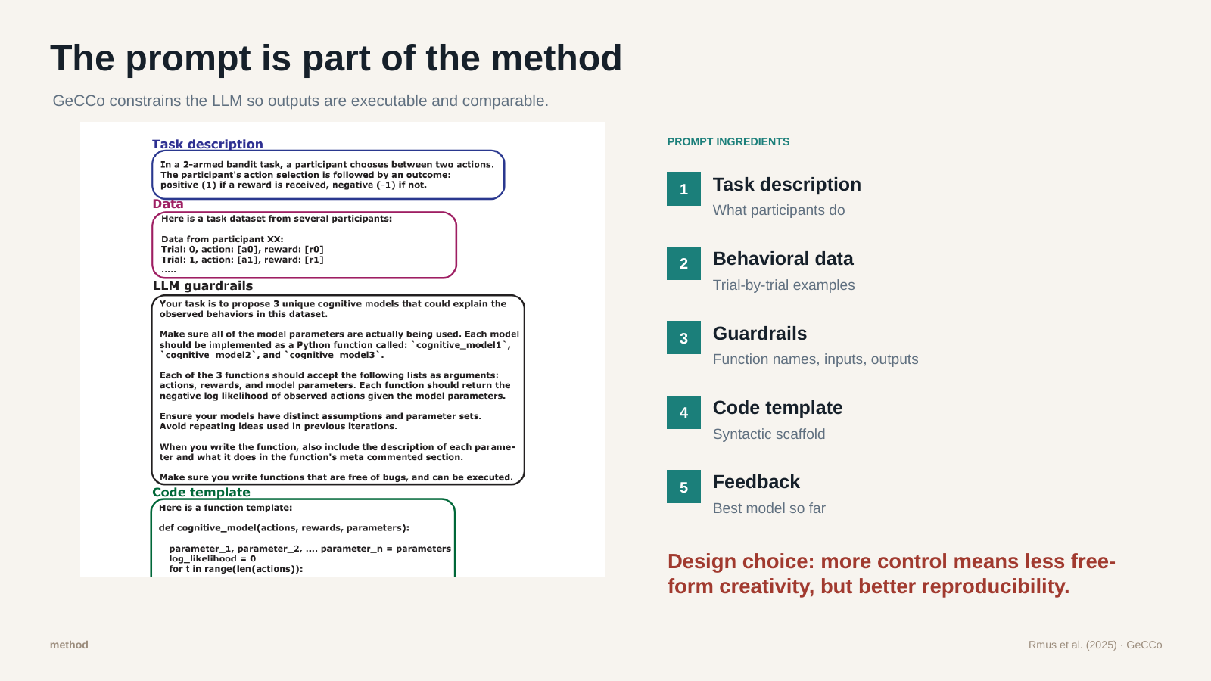
Slide 5: The prompt is part of the method
Speaker 1 · bilingual oral script / 双语口语讲稿
ENGLISH
中文
The prompt itself is an important part of the method.
It has five main ingredients. First, the task description tells the LLM what participants do. Second, behavioral data gives trial-by-trial examples.
Third, guardrails tell the LLM the function name, inputs, outputs, and constraints. Fourth, the code template gives a basic structure.
Fifth, from the second round onward, feedback tells the LLM what the best previous model was.
So the LLM is creative, but not completely free. It is guided to produce models that can actually run and be compared.
这里要强调的是，prompt 本身就是方法的一部分。
它主要有五个部分。第一是任务说明，告诉 LLM 被试在做什么。第二是行为数据，也就是一条一条 trial 的例子。
第三是 guardrails，也就是规则，比如函数名、输入、输出、参数范围，以及代码必须能运行。第四是代码模板，给 LLM 一个基本结构。
第五是反馈。从第二轮开始，LLM 会看到前一轮最好的模型。
所以 LLM 确实有创造性，但它不是完全自由发挥。它被引导去生成可以运行、也可以比较的模型。
Corresponds to final PPT slide 5

Slide 6
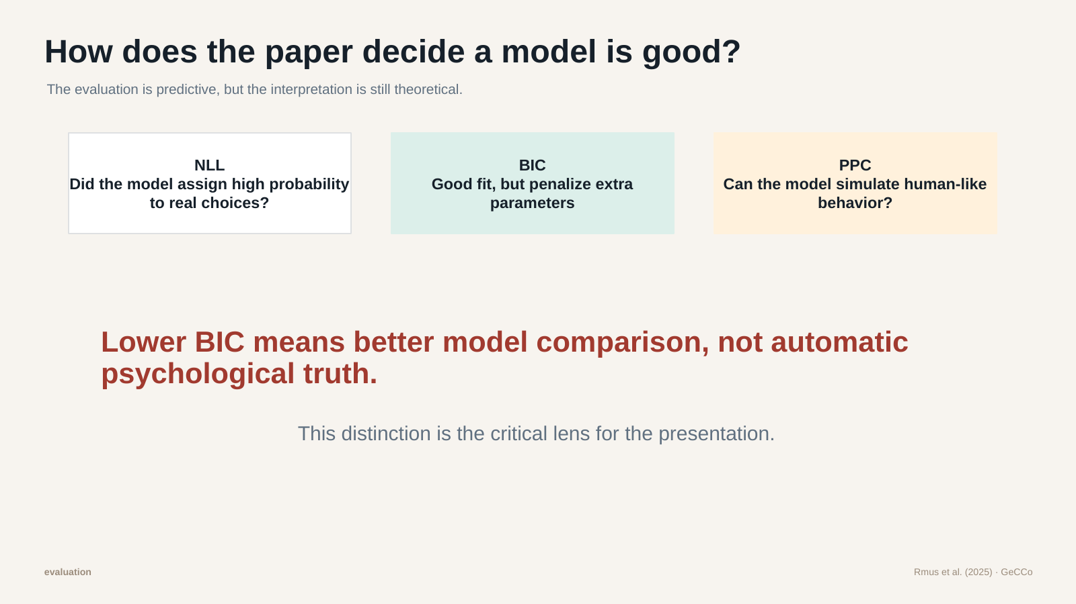
Slide 6: How does the paper decide a model is good?
Speaker 1 · bilingual oral script / 双语口语讲稿
ENGLISH
中文
Now, how do the authors decide whether a model is good?
There are three key ideas. First, negative log-likelihood, or NLL. This asks whether the model gives high probability to the choices people actually made.
Second, BIC. BIC also measures fit, but it penalizes extra parameters. If two models fit similarly well, BIC prefers the simpler one.
Third, posterior predictive check. This means we simulate behavior from the model and check whether it looks like real human behavior.
But the important point is: lower BIC is not psychological truth. It is a comparison score, not final proof of how the mind works.
接下来是评价问题：作者怎么判断一个模型好不好？
这里有三个关键概念。第一个是负对数似然，也就是 NLL。它问的是：模型有没有给真实发生的选择比较高的概率？
第二个是 BIC。BIC 也看拟合好不好，但它会惩罚参数太多的模型。所以如果两个模型拟合差不多，BIC 会更喜欢简单的模型。
第三个是 posterior predictive check。意思是用模型模拟行为，再看模拟出来的行为像不像真实人类行为。
但关键是：更低的 BIC 不等于心理学真相。它是一个模型比较分数，不是“人脑就是这样工作”的最终证明。
Corresponds to final PPT slide 6

Slide 7
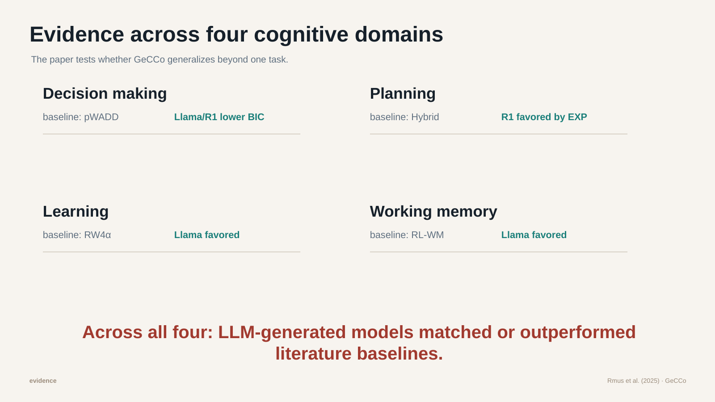
Slide 7: Evidence across four cognitive domains
Speaker 2 · bilingual oral script / 双语口语讲稿
ENGLISH
中文
The authors test GeCCo in four domains: decision making, learning, planning, and working memory.
We do not need to go through every number here. The overall pattern is that LLM-generated models often match or outperform the literature baselines.
But for us, the interesting part is not only the better scores. The interesting part is that the LLM sometimes proposes different mechanisms.
So in the next slides, we focus less on every statistic, and more on what kind of explanation the LLM model gives.
作者在四个认知领域测试了 GeCCo：决策、学习、规划和工作记忆。
这里我们不需要逐个解释每一个数字。整体结果是，LLM 生成的模型经常能够达到，甚至超过文献中的基线模型。
但对我们来说，更有意思的不是分数更高本身，而是 LLM 有时候提出了不同的机制。
所以接下来几页，我们不会陷入每个统计数字，而是重点看 LLM 模型到底给出了什么样的解释。
Corresponds to final PPT slide 7

Slide 8
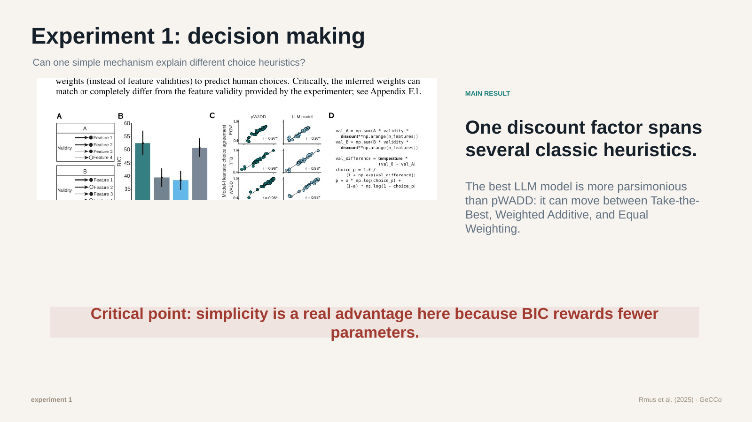
Slide 8: Experiment 1: decision making
Speaker 2 · bilingual oral script / 双语口语讲稿
ENGLISH
中文
The first experiment is about decision making.
Participants choose between two options, like product A and product B. Each option has several features, and some features are more reliable than others.
The classic question is: do people use only the best cue, or do they combine all cues?
The baseline model, pWADD, uses several feature weights. The LLM-generated model finds a simpler solution: one discount factor.
This factor can move between different strategies, from Take-the-Best to weighted cue combination. So here the LLM model is not only good-fitting; it is also compact and interpretable.
第一个实验是关于决策。
被试需要在两个选项之间选择，比如产品 A 和产品 B。每个选项都有几个特征，而且有些特征比其他特征更可靠。
经典问题是：人是只看最可靠的线索，还是把所有线索综合起来？
基线模型 pWADD 使用多个特征权重。LLM 生成的模型给出了一个更简单的方案：一个 discount factor。
这个因子可以在不同策略之间移动，比如从 Take-the-Best 到加权整合线索。所以这里 LLM 模型不只是拟合好，而且更简洁，也比较容易解释。
Corresponds to final PPT slide 8

Slide 9
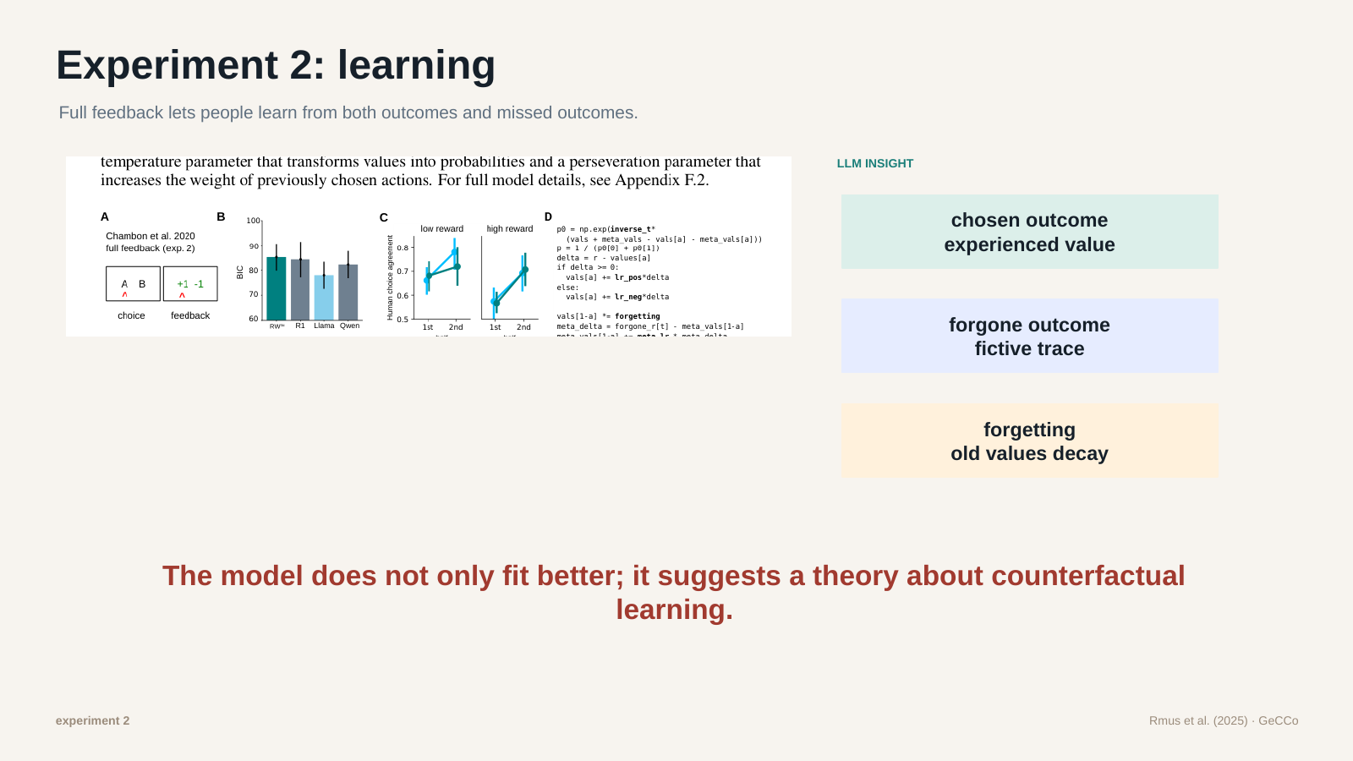
Slide 9: Experiment 2: learning
Speaker 1 · bilingual oral script / 双语口语讲稿
ENGLISH
中文
The second experiment is learning in a two-armed bandit task.
Participants choose between two options and learn from feedback. In the full-feedback condition, they see the reward for the chosen option and also what the unchosen option would have given them.
So people can learn from what happened, and from what could have happened.
The LLM model separates these two sources. It has one value for experienced outcomes and another trace for forgone outcomes.
It also includes forgetting, so old or unchosen options can slowly lose value. Psychologically, this feels intuitive: people learn from rewards, but also from missed opportunities, regret, or relief.
第二个实验是双臂老虎机任务中的学习。
被试在两个选项中选择，并根据反馈学习。在 full-feedback 条件下，他们不仅看到自己选择的选项带来的奖励，也看到没选的选项本来会给什么。
所以人不仅能从实际发生的结果中学习，也能从“本来可能发生的结果”中学习。
LLM 模型把这两类信息分开处理：一条价值来自真实经历过的结果，另一条 trace 来自未选择选项的结果。
它还加入了遗忘机制，所以旧选项或没选的选项价值会慢慢衰减。从心理学上看，这很直观：人不只是从奖励中学习，也会从错过的机会、后悔或庆幸中学习。
Corresponds to final PPT slide 9

Slide 10
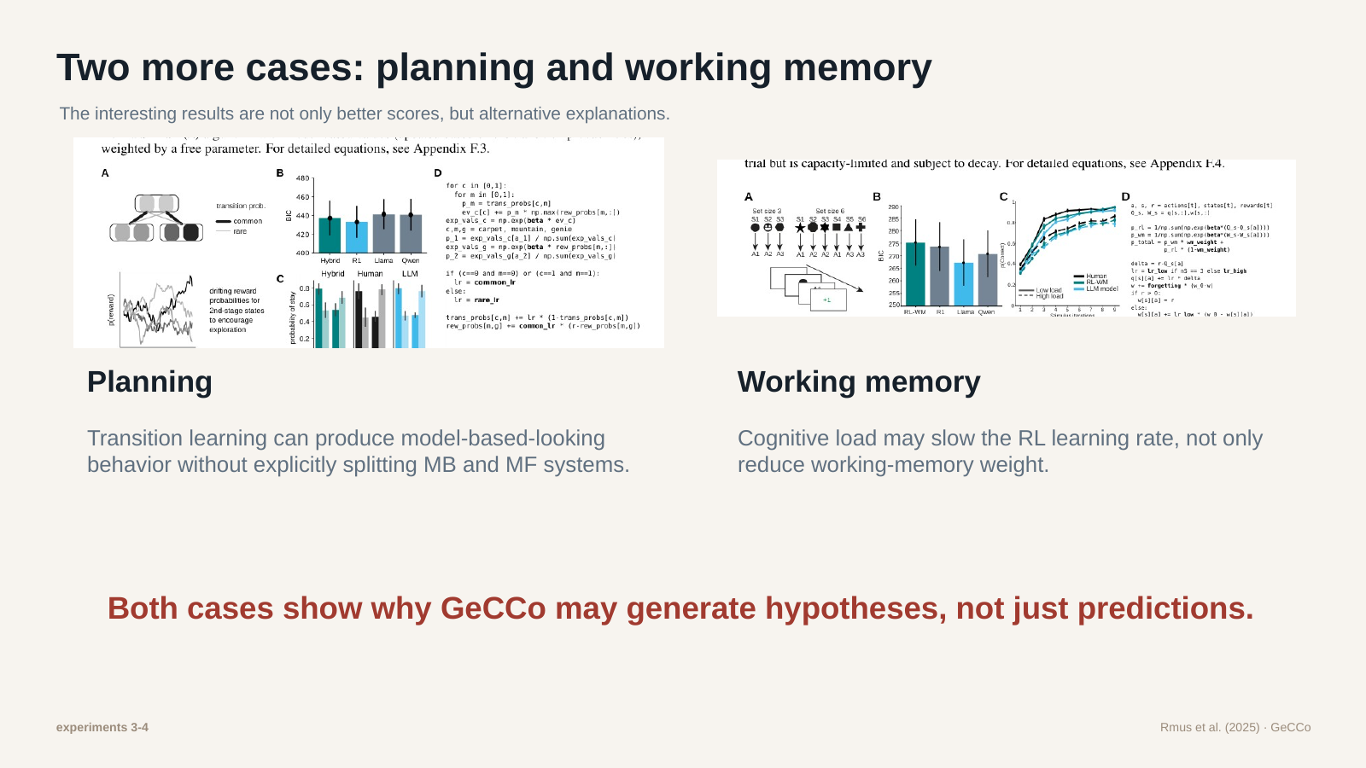
Slide 10: Planning and working memory
Speaker 2 · bilingual oral script / 双语口语讲稿
ENGLISH
中文
The next two experiments are planning and working memory.
For planning, the task is the magic carpet task. Participants choose a carpet, it usually leads to one place but sometimes to another, and then they make a second choice.
Traditionally, this task separates model-free habits from model-based planning. The LLM model instead focuses on learning the transition structure directly.
For working memory, participants learn stimulus-action pairs. Three pairs are low load; six pairs are high load.
The classic view is that high load mainly affects working memory. The LLM model suggests it may also slow reinforcement learning itself.
So GeCCo can generate alternative hypotheses, not just alternative predictions.
接下来两个实验是规划和工作记忆。
规划实验用的是 magic carpet 任务。被试先选一张飞毯，它通常会带到某个地方，但偶尔会带到另一个地方，然后被试再做第二次选择。
传统上，这个任务用来区分 model-free 的习惯学习和 model-based 的规划。LLM 模型则换了一个角度：它直接学习转移结构。
工作记忆实验里，被试要学习刺激和动作的配对。三个配对是低负荷，六个配对是高负荷。
传统观点认为高负荷主要影响工作记忆。但 LLM 模型提出，高负荷也可能让强化学习本身变慢。
所以 GeCCo 不只是给出不同预测，它也可能提出新的假设。
Corresponds to final PPT slide 10

Slide 11
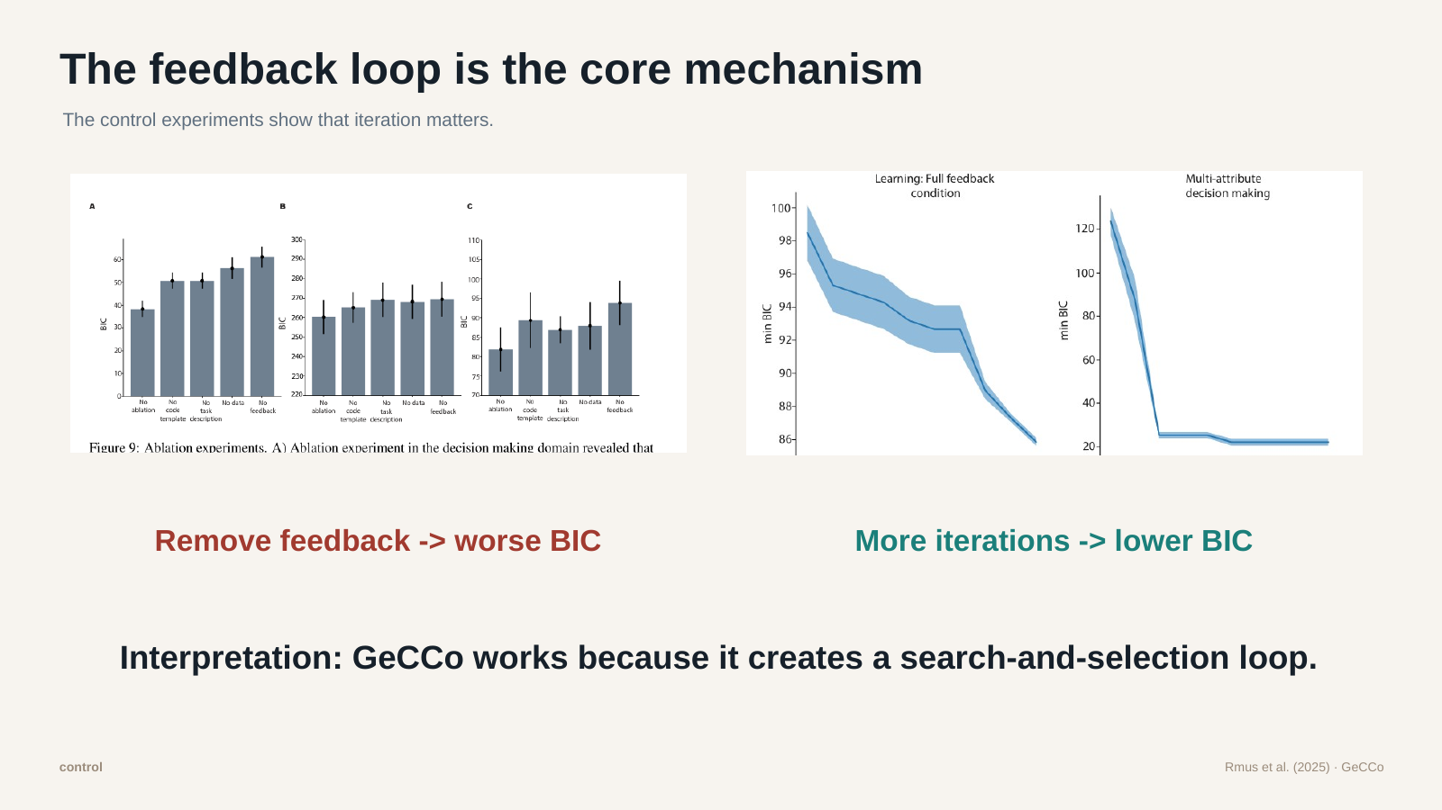
Slide 11: The feedback loop is the core mechanism
Speaker 1 · bilingual oral script / 双语口语讲稿
ENGLISH
中文
Now we move to the control experiments.
This slide is important because it shows that feedback is really central to GeCCo. When the authors remove feedback from the prompt, model performance gets worse.
In other words, the LLM is much less useful if it only guesses once.
The paper also shows that BIC improves across iterations. Later rounds tend to produce better models.
For us, this is one of the strongest parts of the method. GeCCo works because it combines LLM creativity with statistical selection.
Again: the LLM proposes, but the data decides.
现在我们进入控制实验部分。
这页很重要，因为它说明反馈循环确实是 GeCCo 的核心。如果作者把 prompt 里的 feedback 去掉，模型表现就会变差。
换句话说，如果 LLM 只猜一次，它的作用会小很多。
文章还展示了 BIC 会随着迭代下降，也就是后面的轮次通常能产生更好的模型。
对我们来说，这是这个方法最有说服力的地方之一。GeCCo 有效，是因为它把 LLM 的创造性和统计选择结合起来。
还是那句话：LLM 提出模型，但数据决定哪个模型更好。
Corresponds to final PPT slide 11

Slide 12
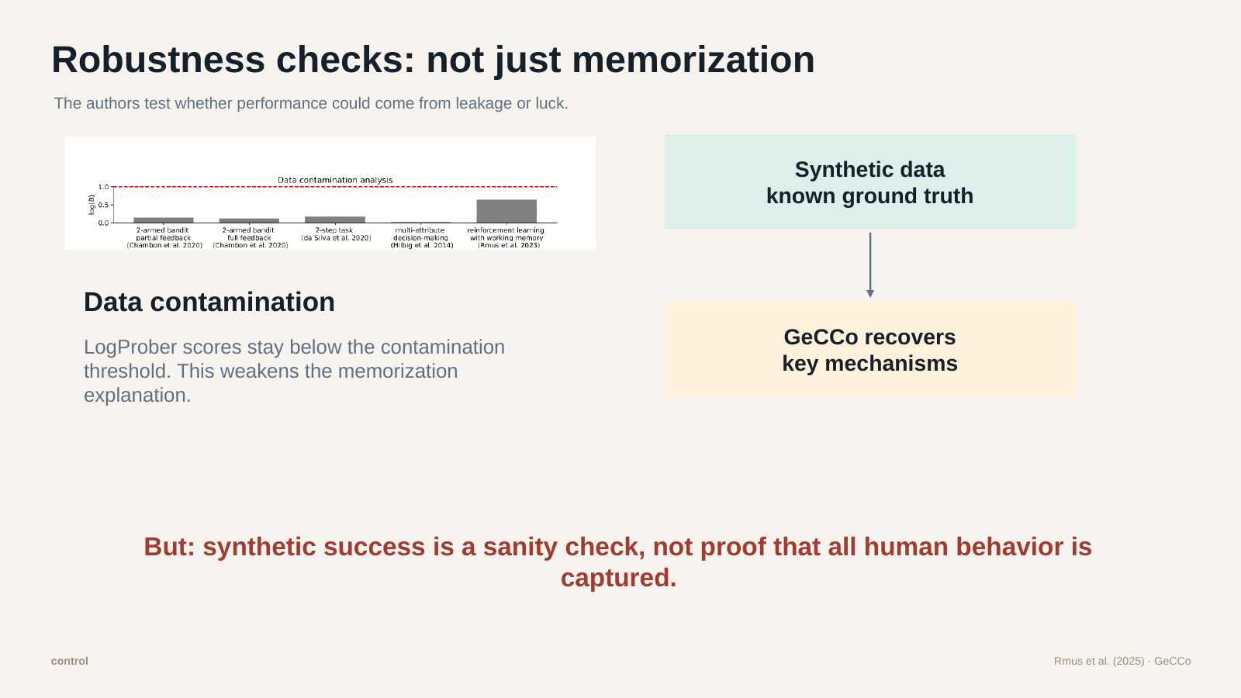
Slide 12: Robustness checks
Speaker 1 · bilingual oral script / 双语口语讲稿
ENGLISH
中文
The authors also try to rule out simple alternative explanations.
One concern is data contamination. Maybe the LLM already saw the dataset or model during training. The authors use LogProber, and the results are below the contamination threshold, so they argue memorization is unlikely.
Another check is synthetic data. Here the authors create fake data where the true model is known. GeCCo can recover important mechanisms from that data.
These checks make the results more credible.
But we should still be careful: synthetic data is a sanity check, not full proof. Real human behavior is usually messier and more complex.
作者还尝试排除一些简单的替代解释。
一个担心是数据污染。也许 LLM 在训练时已经见过这些数据或模型。作者使用 LogProber 检查，结果都低于污染阈值，所以他们认为记忆已有答案的可能性不大。
另一个检查是 synthetic data，也就是模拟数据。在这里，作者自己生成数据，所以知道真正的模型是什么。GeCCo 能从这些数据中恢复出重要机制。
这些检查让结果更可信。
但我们还是要谨慎：模拟数据只是 sanity check，不是完整证明。真实的人类行为通常更混乱，也更复杂。
Corresponds to final PPT slide 12

Slide 13
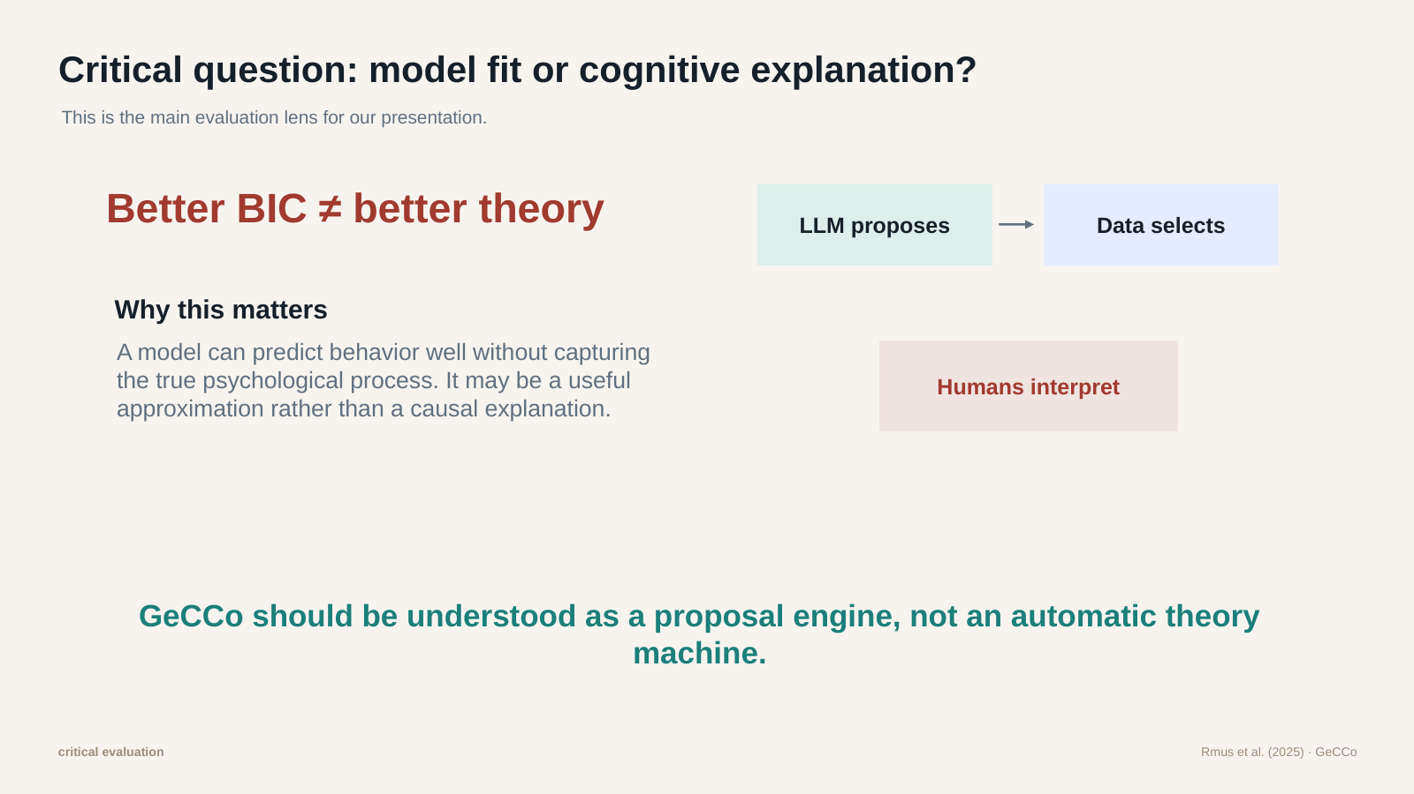
Slide 13: Critical question: model fit or cognitive explanation?
Speaker 2 · bilingual oral script / 双语口语讲稿
ENGLISH
中文
This brings us to our main critical question: are we seeing better model fit, or better cognitive explanation?
A model can predict behavior well without being the true psychological explanation.
For example, a weather model may predict rain well, but that does not mean it explains every physical process in the atmosphere. Similarly, a cognitive model can fit choices well, but still only be an approximation.
So we think the best way to understand GeCCo is as a proposal engine.
The LLM proposes possible models. The data selects models that work well. But humans still need to ask whether the mechanism makes psychological sense.
GeCCo does not replace scientists. It changes what scientists do.
这就引出了我们的核心批判问题：这里看到的是更好的模型拟合，还是更好的认知解释？
一个模型可以很好地预测行为，但不一定就是真正的心理解释。
比如，天气模型可能很好地预测下雨，但这不代表它解释了大气中每一个物理过程。同样，一个认知模型可以很好地拟合选择行为，但它仍然可能只是一个近似。
所以我们认为，理解 GeCCo 最好的方式是把它看作一个 proposal engine。
LLM 提出可能的模型，数据选择表现好的模型。但人类研究者仍然要判断：这个机制在心理学上是否说得通。
GeCCo 不是取代科学家，而是改变科学家的工作方式。
Corresponds to final PPT slide 13

Slide 14
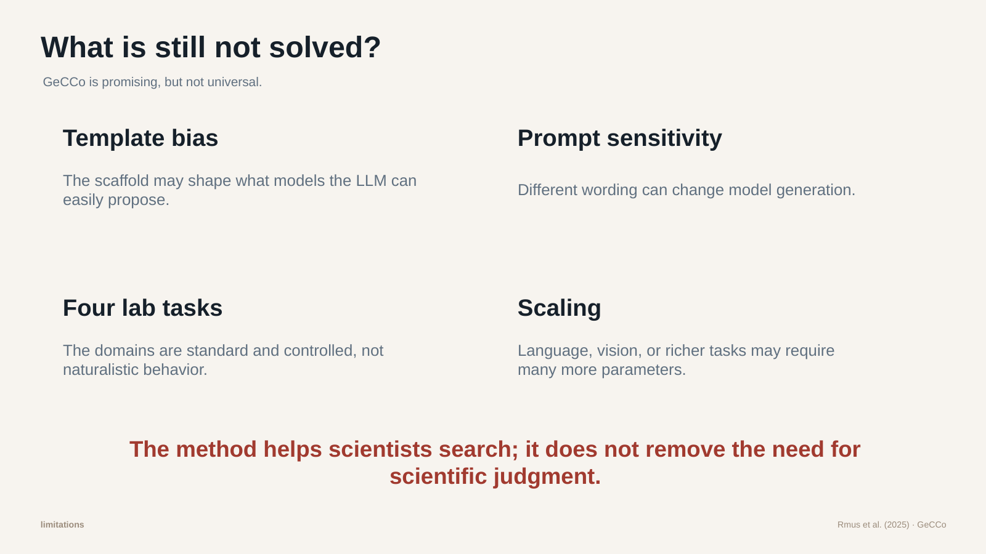
Slide 14: What is still not solved?
Speaker 2 · bilingual oral script / 双语口语讲稿
ENGLISH
中文
There are also limitations.
First, template bias. The LLM gets a code template, and this template may shape what kinds of models it generates.
Second, prompt sensitivity. Different wording may lead to different models, so reproducibility is still an issue.
Third, the paper tests four controlled lab tasks. These are good starting points, but real human behavior is often more naturalistic, noisy, and high-dimensional.
Finally, even if the output is code, that does not automatically make it meaningful. A model can be readable but still theoretically weak.
So GeCCo is promising, but not a magic solution.
当然，这个方法也有局限。
第一是模板偏差。LLM 会拿到一个代码模板，而这个模板可能会影响它生成什么类型的模型。
第二是 prompt 敏感性。不同表述可能会生成不同模型，所以可重复性仍然是问题。
第三，文章只测试了四个受控实验室任务。这些是很好的起点，但真实人类行为往往更自然、更嘈杂，也更高维。
最后，即使输出是代码，也不代表它一定有理论意义。一个模型可以很可读，但理论上仍然比较弱。
所以 GeCCo 很有前景，但不是万能方案。
Corresponds to final PPT slide 14

Slide 15
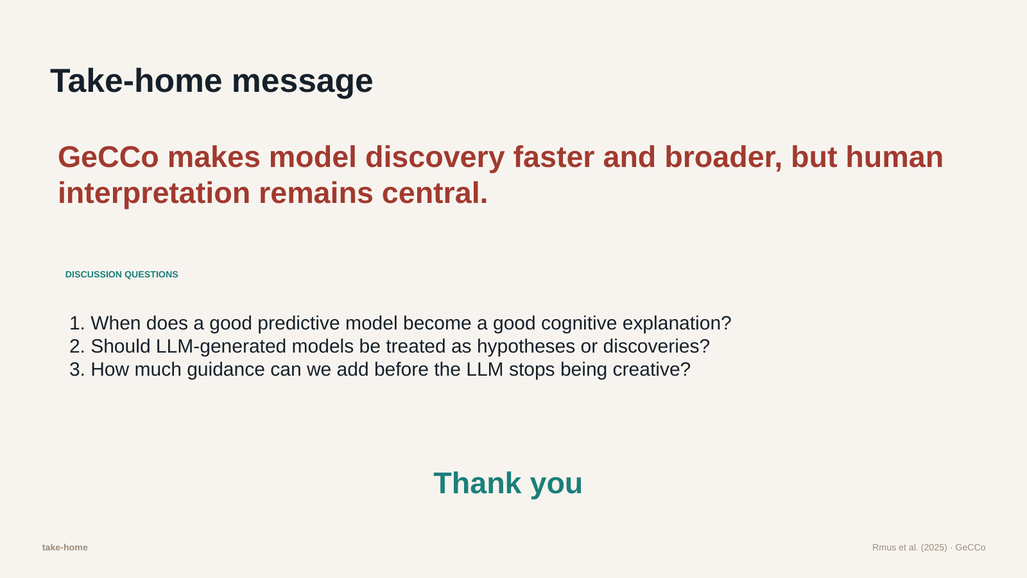
Slide 15: Take-home message
Speaker 1 · bilingual oral script / 双语口语讲稿
ENGLISH
中文
To finish, our take-home message is simple.
GeCCo makes cognitive model discovery faster and broader. It helps researchers explore more possible models than they could manually test.
But final interpretation still belongs to human scientists.
So we can summarize the paper in three steps: LLMs propose, data selects, and humans interpret.
We would like to end with three discussion questions.
First, when does a good predictive model become a good cognitive explanation?
Second, should LLM-generated models be treated as hypotheses, or as discoveries?
Third, how much guidance can we give the LLM before it stops being genuinely creative?
Thank you for listening. We are happy to take your questions.
最后，我们的 take-home message 很简单。
GeCCo 让认知模型发现变得更快，也让模型搜索范围更广。它帮助研究者探索更多手工很难逐一测试的模型。
但是，最后的解释权仍然属于人类科学家。
所以这篇文章可以用三句话概括：LLM 提出模型，数据选择模型，人类解释模型。
最后我们想留下三个讨论问题。
第一，一个预测效果好的模型，什么时候才算是好的认知解释？
第二，LLM 生成的模型应该被看作假设，还是发现？
第三，我们可以给 LLM 多少引导，才不会让它失去真正的创造性？
谢谢大家，我们欢迎大家提问。
Corresponds to final PPT slide 15

